Slide 1
Relating to Muslims
Love
MUSLIM
Globalism 
Attack
ISLAM
Accept
◆ Barrier Building
◆ Nationalism
ISIS 
Hate

Slide 2
Barrier Building
Based on his book, in August 2012, UK history professor Tom Holland produced a documentary for British television entitled Islam: The Untold Story, which provoked what he described as "a firestorm of death threats" against him. The broadcast was cancelled but it can be viewed online.

Slide 3
Relating to Muslims
Love
MUSLIM
◆ “Apologists”
Globalism 
Attack
ISLAM
Accept
◆ Barrier Building
◆ Nationalism
ISIS 
Hate

Slide 4
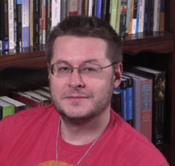
https://en.wikipedia.org/wiki/ Jay_Smith_(Christian_apologist)
Attacking Islam
https://en.wikipedia.org/wiki/
David_Wood_(Christian_apologist)

Slide 5
Relating to Muslims
Love
MUSLIM
“Christianizer” 
◆ “Apologists”
Globalism 
Attack
ISLAM
Accept
◆ Barrier Building
◆ Nationalism
ISIS 
Hate

Slide 6
http://morethandreams.org/

Slide 7
Relating to Muslims
Love
◆ Bridge Building
MUSLIM
◆ “Apologists”
“Christianizer” 
Globalism 
Attack
ISLAM
Accept
◆ Barrier Building
◆ Nationalism
ISIS 
Hate

Slide 8
Bridge Building to Afghan Community
Rev. Bruce Green
Bridge Building Facilitator

Slide 9
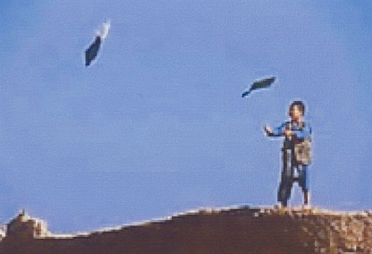
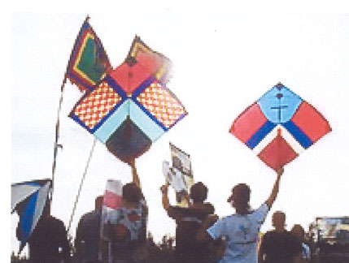
The K.I.T.E. Approach
Kindness
Involvement
Trust
Exalt Jesus

Slide 10
Kingdom of God
Jews
?
The Favorite Topic of Jesus
What People Group did Jesus focus on?
Notes:
Jesus primarily ministered in his own Jewish culture.
His theme was the “Kingdom of God” and he was inviting all men to enter it.

Slide 11
Kingdom of God
Jews
Notes:
He never tried to “convert” Jews to Christianity. He never used the word “Christian.”

