Slide 1
Jesus in the Old Testament

Slide 2
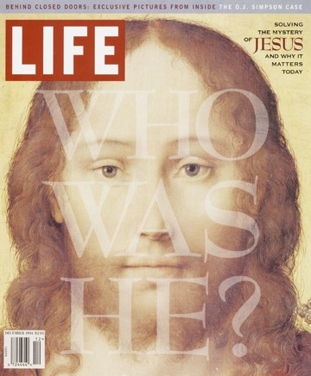
Who Was He?

Slide 3
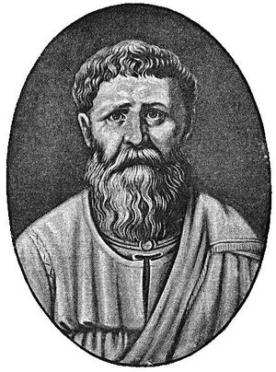
“The New Testament is in the Old concealed. The Old Testament is in the New revealed.”
(Augustine, 4th C.)

Slide 4
Luke 24:13-27
¹³ And behold, two of them were going that very day to a village named Emmaus, which was about seven miles from Jerusalem.¹⁴ And they were talking with each other about all these things which had taken place. ¹⁵While they were talking and discussing, Jesus Himself approached and began traveling with them. ¹⁶ But their eyes were prevented from recognizing Him.¹⁷ And He said to them, “What are these words that you are exchanging with one another as you are walking?”

Slide 5
Luke 24:13-27
And they stood still, looking sad.
¹⁸ One of them, named Cleopas, answered and said to Him, “Are You the only one visiting Jerusalem and unaware of the things which have happened here in these days?”¹⁹ And He said to them, “What things?”
And they said to Him, “The things about Jesus the Nazarene, who was a prophet mighty in deed and word in the sight of God and all the people,

Slide 6
Luke 24:13-27
²⁰ and how the chief priests and our rulers delivered Him to the sentence of death, and crucified Him. ²¹ “But we were hoping that it was He who was going to redeem Israel. Indeed, besides all this, it is the third day since these things happened. ²²
“But also some women among us amazed us. When they were at the tomb early in the morning,
²³ and did not find His body, they came, saying that they had also seen a vision of angels who said that He was alive.

Slide 7
Luke 24:13-27
²⁴ “Some of those who were with us went to the tomb and found it just exactly as the women also had said; but Him they did not see.”²⁵ And He said to them, “O foolish men and slow of heart to believe in all that the prophets have spoken! ²⁶ “Was it not necessary for the Christ to suffer these things and to enter into His glory?” ²⁷ Then beginning with Moses and with all the prophets, He explained to them the things concerning Himself in all the Scriptures.

Slide 8
Genesis 3:15
And I will put enmity Between you and the woman, And between your seed and her seed;
He shall bruise you on the head, And you shall bruise him on the heel.”

Slide 9
Deuteronomy 18:18-19
I will raise up a prophet from among their countrymen like you, and I will put My words in his mouth, and he shall speak to them all that I command him. It shall come about that whoever will not listen to My words which he shall speak in My name, I Myself will require it of him.”

Slide 10
Micah 5:2
But as for you, Bethlehem Ephrathah, Too little to be among the clans of Judah,
From you One will go forth for Me to be ruler in Israel.
His goings forth are from long ago, From the days of eternity.”

Slide 11
Isaiah 53
⁵But He was pierced through for our transgressions, He was crushed for our iniquities; The chastening for our well-being fell upon Him, And by His scourging we are healed.
⁶ All of us like sheep have gone astray, Each of us has turned to his own way; But the LORD has caused the iniquity of us all…

Slide 12
Daniel 9:24-26
²⁴ “Seventy weeks have been decreed for your people and your holy city, to finish the transgression, to make an end of sin, to make atonement for iniquity, to bring in everlasting righteousness, to seal up vision and prophecy and to anoint the most holy place.
²⁵ “So you are to know and discern that from the issuing of a decree to restore and rebuild Jerusalem until Messiah the Prince there will be seven weeks and sixty-two weeks; it will be built again, with plaza and moat, even in times of distress.²⁶ Then after the sixty-two weeks the Messiah will be cut off and have nothing, and the people of the prince who is to come will destroy the city and the sanctuary.

Slide 13
Psalm 22
¹My God, my God, why have you forsaken me?
⁷ All who see me sneer at me; They separate with the lip, they wag the head, saying,: ⁸ “Commit yourself to the LORD; let Him deliver him; ”
¹⁴ I am poured out like water, And all my bones are out of joint; My heart is like wax; It is melted within me. ¹⁶ They pierced my hands and my feet. ¹⁷ I can count all my bones. They look, they stare at me;¹⁸ They divide my garments among them, And for my clothing they cast lots.

Slide 14
30 Prophecies Fulfilled!
10,000,000,000, 000,000,000, 000,000,000, 000,000,000, 000,000,000, 000,000,000, 000,000,000, 000,000,000, 000,000,000, 000,000,000, 000,000,000,

