Slide 1
Daniel 3:1 – 4:2 God’s deliverance of Hananiah, Mishael, & Azariah’s from Nebuchadezzer
Sam Kim
June 13, 2021

Slide 2
Why we need a Shepherd….

Slide 3
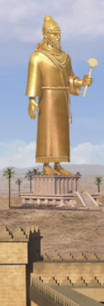
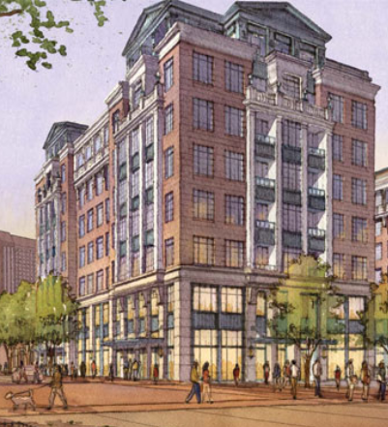
1. Nebuch builds & idol & demands worship (Dan. 3:1-7)

Slide 4
Daniel 3 - Outline
Nebuch builds a large “golden” idol and demands worship (Dan. 3:1-7)
Accusations against the three(Dan. 3:8-12)
Nebuch’s furious rage and final warning (Dan. 3:13-15)
Bold, clear, unified response to the king (Dan. 3:16-18)
The three thrown into the fiery furnace (Dan. 3:19-23)
God’s miraculous deliverance (Dan. 3:24-25)
Nebuch’s pivot (Dan. 3:26-29)
The three promoted again(Dan. 3:30)
Nebuch give further glory to God (Dan. 4:1-2)

Slide 5
Daniel 3 – Applications
Fear GOD above ALL!
Be wise in your choice of friends
Be understanding of the times
Be steadfast in your faith
God is actively preparing us (Sanctification!)
Be shrewd about people’s profession of faith
We are in a spiritual battle

Slide 6
To God be the glory!

