Slide 1
Psalm 127 The futility of life apart from Jesus
Sam Kim
August 1, 2021

Slide 2
Outline of the message
Contentment/Satisfaction
Protection/Security
Labor/Rest
Legacy/Heritage

Slide 3
I. Contentment/Satisfaction
Psalm 127:1a “Unless the Lord builds the House those who build it labor in vain
Deut. 1ff
God’s way
Israel’s rebellion
Futile/vain consequences

Slide 4
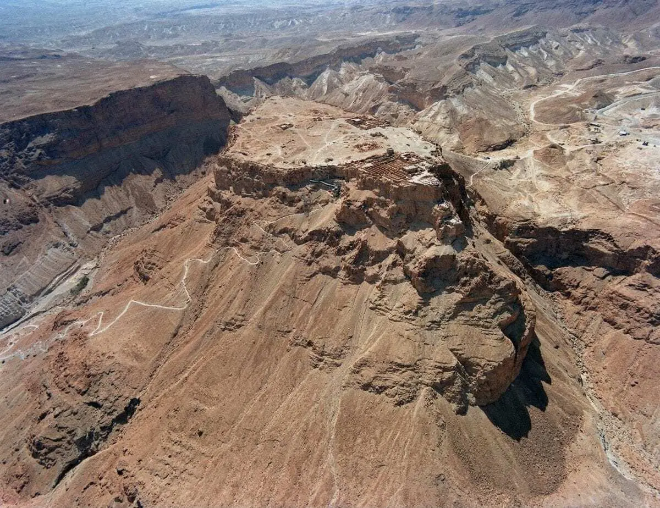
II. Protection/Security
Masad
Built by Herod the Great (37-4 BC)

Slide 5
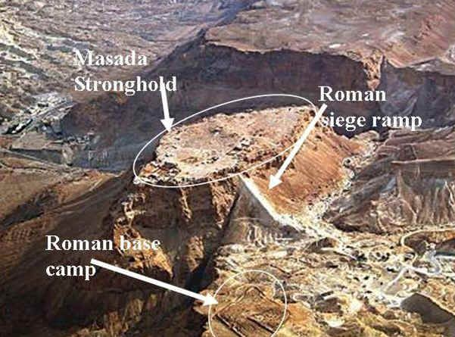
Masada impenetrable?
Psalm 127:1b
“Unless the Lord watches over the city, the watchman stays awake in vain”

Slide 6
III. Labor/Rest vs. anxious toil/no rest
Genesis 6-8 Noah building the Ark
1 Kings 18
Elijah vs. the 450 prophets of Baal
1 Kings 19 – God grants Elijah rest

Slide 7
IV. Legacy/heritage Psalm 127:3-5
Psalm 127:3-5 Not what we do, but God’s gift!
Genesis 16
Abram and Sarai’s choice/plan to “help” God
Genesis 20
Abraham and Sarah receive God’s blessing

Slide 8
Reflections for today…
Are you building your life according to God’s will?
What do you fear or is a source of insecurity?
What are your striving for? Eating the bread of anxious toil? Are you able to sleep?
If your life were to end today, what would your legacy/heritage be?

Slide 9
Recommendations/Applications
Contentment/Satisfaction: Build your house/life on Jesus!
Protection/Security: Put your trust in God and fear not!
Labor/Rest: Stop focusing on self and focus on Jesus
Legacy/Heritage: God’s gift of spiritual/physical family

Slide 10
To God be the glory!

