Slide 1
God’s providence in the family line of Jesus
Pastor Sam Kim
December 12, 2021

Slide 2
Galatians 4:4-7
But when the fullness of time had come, God sent forth his Son, born of woman, born under the law, to redeem those who were under the law, so that we might receive adoption as sons. And because you are sons, God has sent the Spirit of his Son into our hearts, crying, “Abba! Father!”
So you are no longer a slave, but a son, and if a son, then an heir through God.

Slide 3
Credentials: #1 The Royal Line of Jesus (1:1-17)
Abraham Covenant (Gen. 14:1-21) Seed & Land | David (Uriah’s Wife) Covenant (2 Sam 7:8-16) A Son | Jeconiah (From Exile) & his brothers
Isaac | Solomon | Shealtiel
Jacob | Rehoboam | Zerubbabel
Judah (Tamar) | Abijah | Abiud
Perez | Asaph | Eliakim
Hezron | Jehoshaphat | Azor
Ram | Jorom | Zadok
Amminadab | Uzziah | Achim
Nahshon | Jotham | Eliud
Salmon (Rahab) | Ahaz | Eleazar
Boaz (Ruth) | Hezekiah | Matthan
Obed | Manasseh | Jacob
Jesse | Amos | Joseph (Mary)
 | Josiah | Jesus, the Messiah

Slide 4
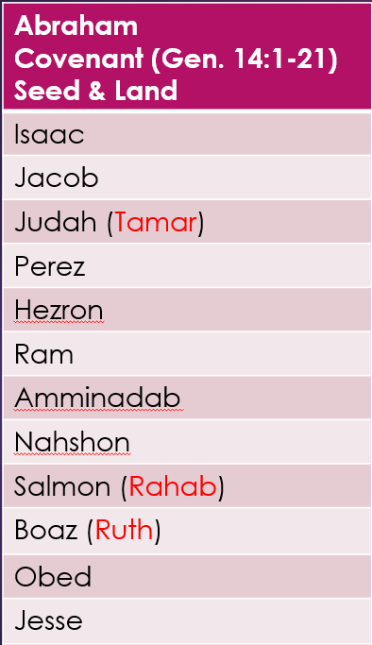
Abraham to David
Timeframe: ~2100-1100 B.C.
Patriarchs
Slavery in Egypt (430 yrs.)
Miraculous deliverance – trek to Promised Land
Conquering the Promised Land
Times of the Judges

Slide 5
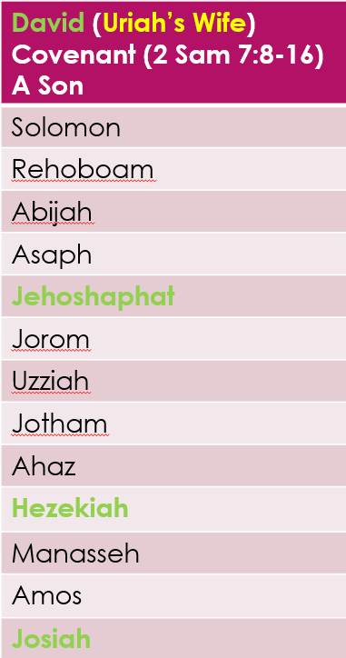
David to the Exile
Timeframe: ~1100 - 550 B.C.
Very few good kings
Split of the North/South (Judah)
Athaliah nearly wiped out the line of David – down to 1 yr. old Joash
Fall of the North: Samaria (722 BC)
Fall of the South: Jerusalem (586 BC)
Judah exiled to Babylon

Slide 6
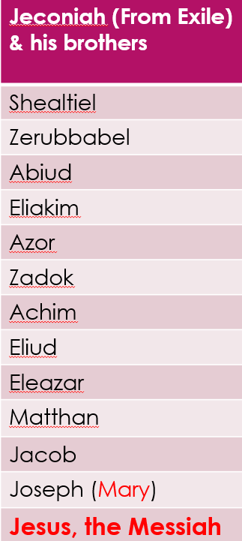
Exile to the Birth of Christ!
Timeframe: ~550 BC – birth of Jesus
Daniel, Ezekiel, faithful remnant exiled to Babylon
Return of Zerubabel to rebuild the temple
400 years of silence
Birth of Jesus

Slide 7
Summary
Jesus is the KING (Messiah/Christ)
Planned by the Trinity
What of genealogies today?
God takes His Word/Covenants seriously!
True sons of Abraham

Slide 8
Application
Chose Jesus as your KING or else….
Live knowing that the 2nd Coming of Jesus will happen!
Remember that God knows you!

Slide 9
To God be the glory!

