Slide 1
Coronation & worship by foreign dignitaries Matthew 2:1-12
Pastor Sam Kim
December 26, 2021

Slide 2
Matthew 2:1-12
Now after Jesus was born in Bethlehem of Judea in the days of Herod the king, behold, wise men from the east came to Jerusalem, ² saying, “Where is he who has been born king of the Jews? For we saw his star when it rose^{[b]} and have come to worship him.” ³ When Herod the king heard this, he was troubled, and all Jerusalem with him; ⁴ and assembling all the chief priests and scribes of the people, he inquired of them where the Christ was to be born. ⁵ They told him, “In Bethlehem of Judea, for so it is written by the prophet:
⁶ “‘And you, O Bethlehem, in the land of Judah, are by no means least among the rulers of Judah;for from you shall come a ruler who will shepherd my people Israel.’”
⁷ Then Herod summoned the wise men secretly and ascertained from them what time the star had appeared. ⁸ And he sent them to Bethlehem, saying, “Go and search diligently for the child, and when you have found him, bring me word, that I too may come and worship him.” ⁹ After listening to the king, they went on their way. And behold, the star that they had seen when it rose went before them until it came to rest over the place where the child was. ¹⁰ When they saw the star, they rejoiced exceedingly with great joy. ¹¹ And going into the house, they saw the child with Mary his mother, and they fell down and worshiped him. Then, opening their treasures, they offered him gifts, gold and frankincense and myrrh. ¹² And being warned in a dream not to return to Herod, they departed to their own country by another way.

Slide 3
Summary of the Credential of Jesus to be Messiah
#1Royal Messianic line: Seed of Abraham and Son of David (Matt. 1:1-17)
#2 God Incarnate by the Holy Spirit (Virgin Birth) (1:18-25)
#3 Coronation & worship by foreign dignitaries (2:1-12)

Slide 4
4 Great Empires prophesied by Daniel
Babylon – Head of fine gold
Medo-Persia – Chest & arms of silver
Greek – thighs of bronze
Roman – legs of iron

Slide 5
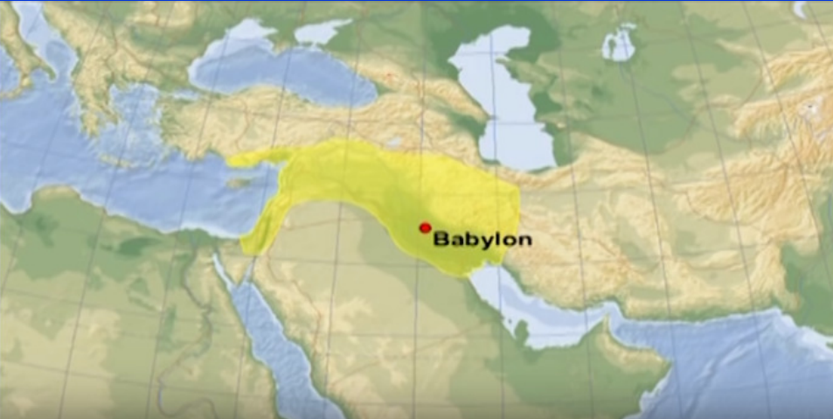
The Babylonia Empire 606-539 BC

Slide 6
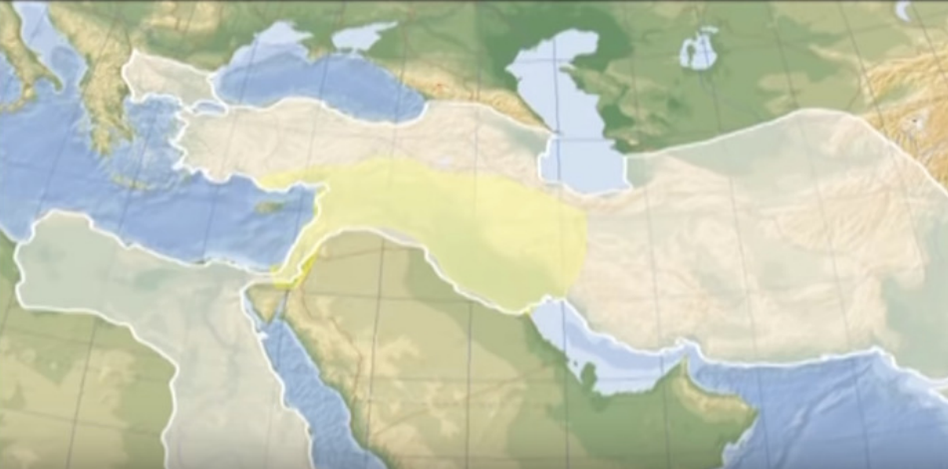
The Medo-Persian Empire 539-332 BC

Slide 7
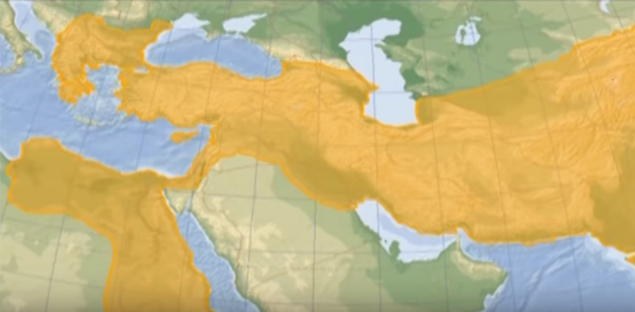
The Greek Empire 332-68 BC

Slide 8
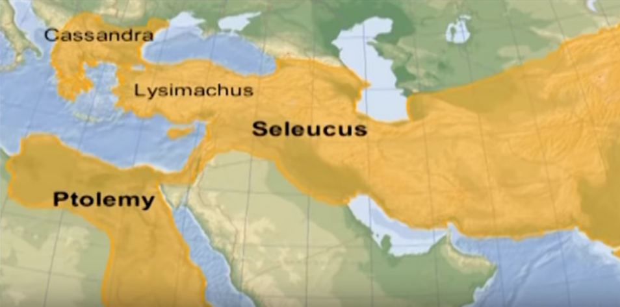
Greek Empire (after death of Alexander the Great)

Slide 9
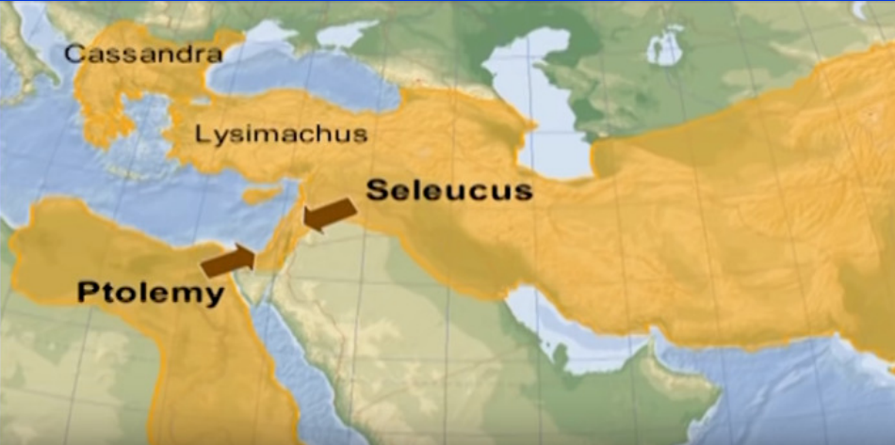
Battle between Ptolemy & Seleucus for supremacy (post Alexander)

Slide 10
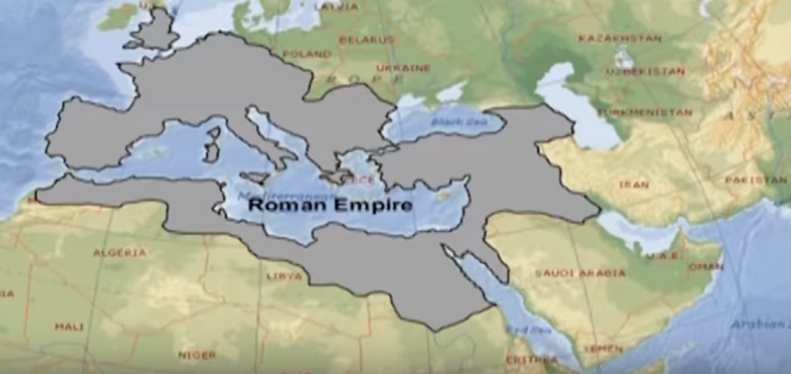
The Roman Empire 68 BC – 476 AD

Slide 11
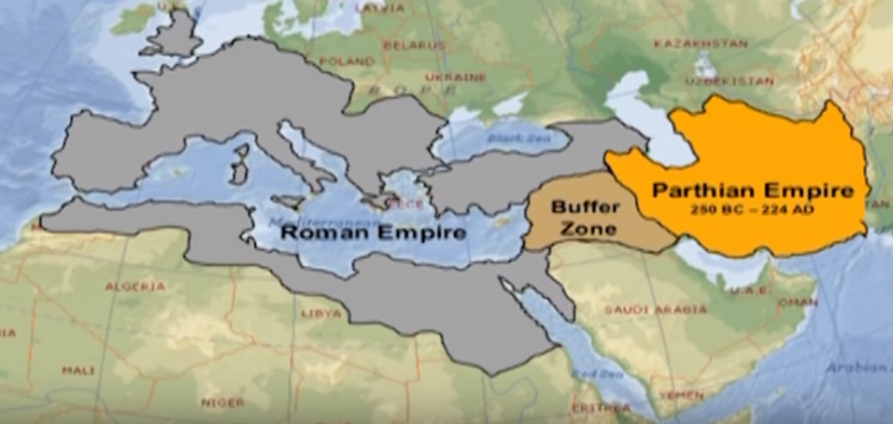
Romans unable to conquer the Parthians

Slide 12
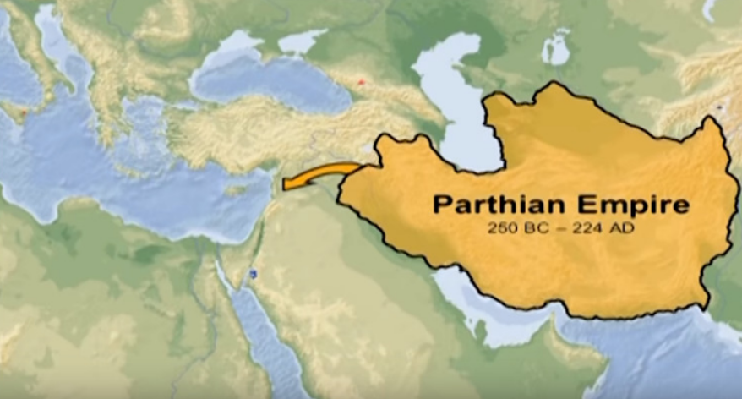
The wise men coming to Jerusalem

Slide 13
Outline of the passage
Arrival of the wise men looking for the new-born King of the Jews (vv. 1-2)
Herod was greatly troubled, disturbed, perplexed, agitated, stirred up; along with all of Jerusalem… but why? (v. 3)
Herod call the religious leaders to search the scriptures (vv. 4)
Answer from the prophet Micah as to where the King was to be born (vv. 5-6)
Attempt of Herod to have the wise men report to him regarding the timing for the birth of Jesus (vv. 7-8)
Arrival of the wise men in Bethlehem where they worshipped the Child and presented their gifts (vv. 9-12)

Slide 14
Matt. 2:1-12: Summary & Application
Messianic Credential #3 – Coronation by foreign dignitaries
True belief of the Wise Men
What about us?

Slide 15
To God be the glory!

