Slide 1
The Testing of the King by the Devil Matthew 4:1-11
Pastor Sam Kim
January 30, 2022

Slide 2
^{Scripture Reading from}
^{Matthew 4:1-11 (ESV)}

Slide 3
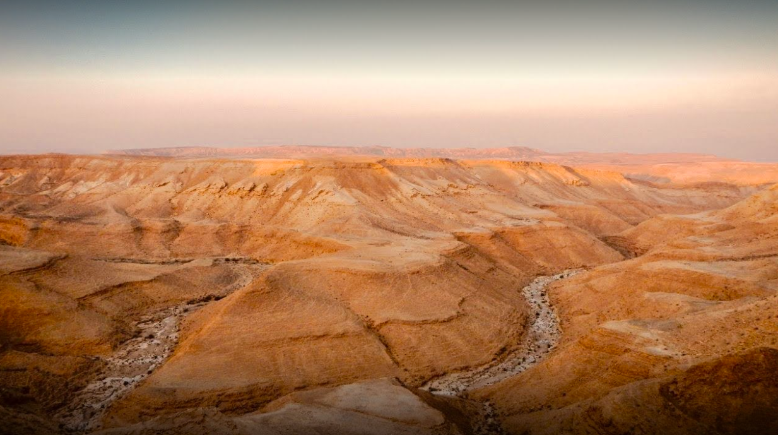
Judean Wilderness – Temptation #1 “Then Jesus was led up by the Spirit to be tempted by the devil…”

Slide 4
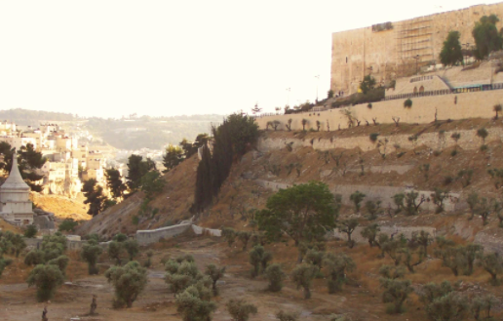
Pinnacle of the Temple Temptation #2

Slide 5
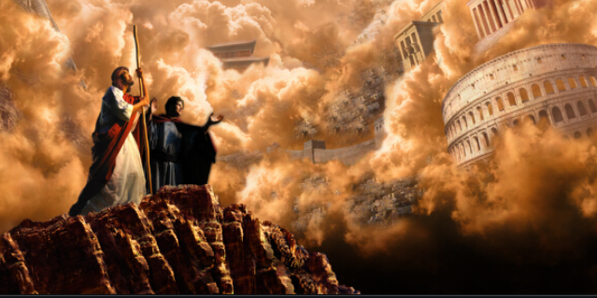
Temptation #3 Splendors of the world….

Slide 6
In summary
Things we learn about Jesus…
Things we learn about Satan…
Word of encouragement (John 16:32-33)

Slide 7
To God be the glory!

