Slide 1
What the Bible says about temptation? Part 2 James 1:2-4 & 12-15
Pastor Sam Kim
February 13, 2022

Slide 2
^{Scripture Reading from}
^{James 1:2-4 & 12-15}
^{ESV}

Slide 3
Sources of Thoughts…leading to Actions
God
Spirit + Word
Mind
Heart-SIN Decisions
Flesh
Other People
ACTIONS
Circumstances
Health: Diet, Rest, Exercise…
Demons

Slide 4
The nature of temptation James 1 Pathway for sinful man…
Various Trials/tests
Lured and enticed by own desires
God does not
Tempt to SIN
Romans 1
SIN(S)
Futile in their thinking…
Foolish heart darkened…
Death
Therefore, God gave them up in in
the lusts of their hearts to impurity, to the
dishonoring of their bodies among themselves, because they exchanged the truth about God for a lie and worshiped and served the creature rather than the Creator….

Slide 5
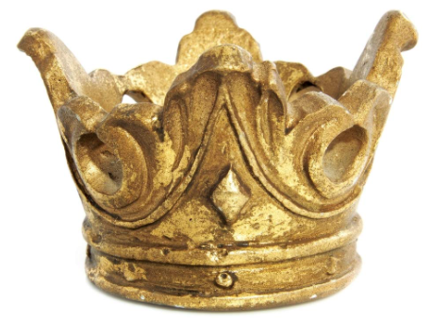
Testing to spiritual maturity James 1 – Pathway to Life…
Perfection
Completeness
Lacking nothing
Justification
Glorification
Steadfastness
Sanctification
FAITH
Leading by the Holy Spirit
Sealed
Various Trials/tests

Slide 6
Testing | Jesus Matt. 4:1-11 | Israel Exodus | Adam Gen. 3
Days in the Desert (Hard times) | 40 Days | 40 years | N/A - Paradise
Hunger Physical duress | Patience/Wait for Provision | Grumbled Manna | No experience
Putting God to the Test | Refused to test but trust God | Is the Lord, among us? | Is God holding back good?
Worshipping other Gods (vs. Faith in God) | Rejected Satan’s short-cut offer Rebuked Satan | Forgot God Golden Calf Foreign Gods | Forgot God SELF – Ambition Believed Satan
 | How about for you & me?

Slide 7
To God be the glory!

