Slide 1
King Jesus begins his ministry Matthew 4:12-17 Pastor Sam Kim February 20, 2022

Slide 2
Matthew 4:12-17 The King begins his ministry
Now when he heard that John had been arrested, he withdrew into Galilee. ¹³ And leaving Nazareth he went and lived in Capernaum by the sea, in the territory of Zebulun and Naphtali, ¹⁴ so that what was spoken by the prophet Isaiah might be fulfilled: ¹⁵ "The land of Zebulun and the land of Naphtali, the way of the sea, beyond the Jordan, Galilee of the Gentiles- ¹⁶ the people dwelling in darkness have seen a great light, and for those dwelling in the region and shadow of death, on them a light has dawned." ¹⁷ From that time Jesus began to preach, saying, "Repent, for the kingdom of heaven is at hand."

Slide 3
Context of Matthew 4
The King defeats Satan (4:1-11)
Exploring the gap between Matt. 4:11 & 4:12
The King begins his ministry in Capernaum. But why Capernaum?
The King’s method and message

Slide 4
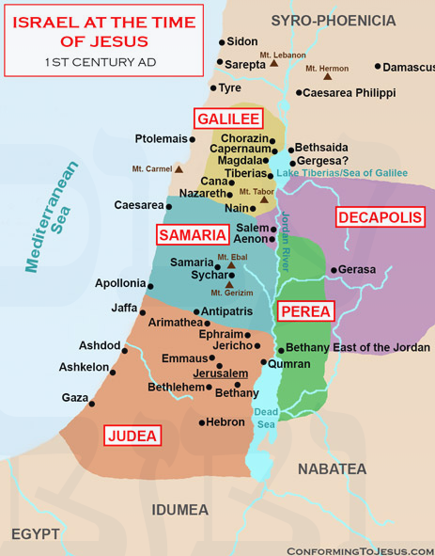

Slide 5
To God be the glory!

