Slide 1
Matt 5: - Blessed are the meek… Pastor Sam April 10, 2022

Slide 2
SCRIPTURE READING
Matthew 5:1-12

Slide 3
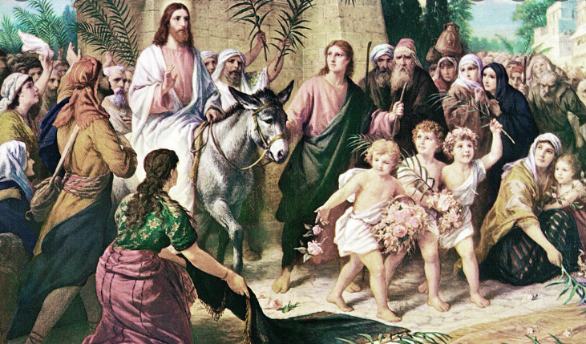
Today is PALM SUNDAY…..

Slide 4
Hebrews 12:2
“Let us fix our eyes on Jesus, the author and perfecter of our faith, who for the joy set before Him endured the cross, scorning its shame, and sat down at the right hand of the throne of God.”

Slide 5
Review:
Blessed are the poor in spirit
for theirs is the Kingdom of God
Blessed are those who mourn
for they will be comforted.
Today:
Blessed are the meek for they will inherit the earth.

Slide 6
Biblical “Meekness”
“Meek” → Greek “Paos” or “Prau’us”
Negative example: King Saul
English synonyms: “Kind-hearted”, “sweet-spirited”, “self-controlled”, “patient”

Slide 7
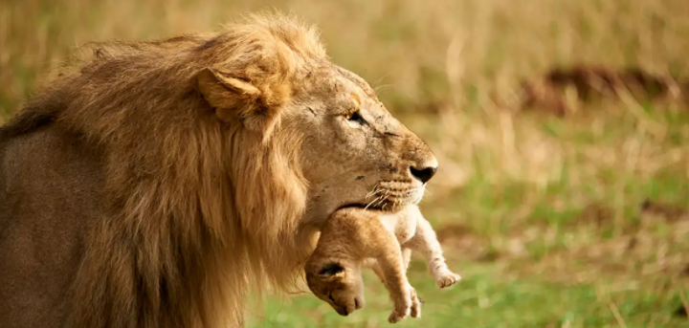
Meekness =
“Power under
God’s Control”

Slide 8
Biblical Examples of Meekness…
Abraham & Lot (Gen. 13)
David sparing Saul (1 Sam. 24 & 26)
Shadrach, Meshach, & Abednego
(Dan. 3)

Slide 9
God’s reward - Inheritance
For the Faithful/Meek (Hebrews 11:13-14)
Jesus preparing a place (John 14:1-3)

Slide 10
Call to Action – 1 Peter 5:6-7
Humble ourselves…
Trust in God’s timing
Cast all our anxieties on Him
Remember that he cares for us

Slide 11
To God be the glory!

