Slide 1
Easter 2022 Matthew 5:6 Blessed are the Meek Pastor Sam April 17, 2022

Slide 2
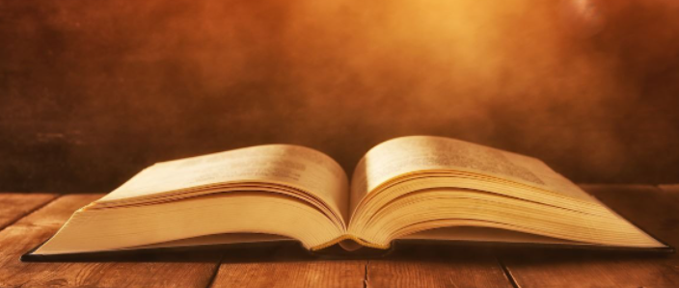
Scripture Reading
Luke 24:1-12
&
Matthew 5:1-6

Slide 4
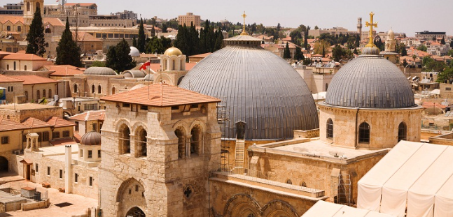
Church of the Holy Sepulchre, Jerusalem

Slide 5
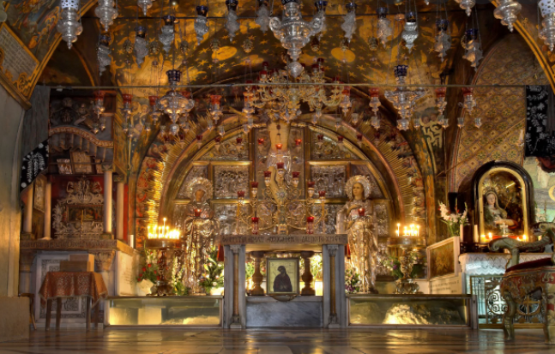
Believed to be the location of the crucifixion

Slide 6
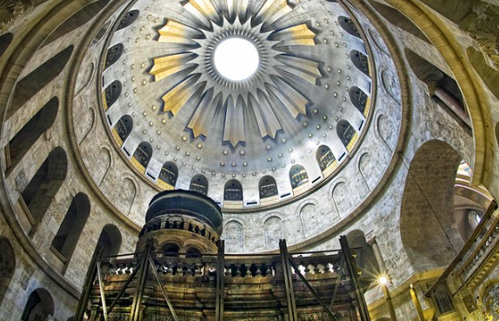
Location where Jesus was believed to be buried

Slide 7
“Stone of Unction” - where it is believed that the body of Jesus was laid

Slide 8
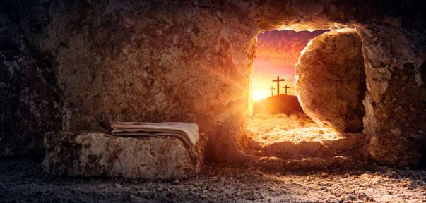
HE IS RISEN!

Slide 9
The first 4 Beatitudes
Blessed are the poor in Spirit for theirs is the Kingdom of God
Blessed are those who mourn for they will be comforted
Blessed are the meek for they will inherit the earth
Blessed are those who hunger & thirst for righteousness for they will be satisfied

Slide 10
Jesus healing an old woman & a young girl
In Common | Different
Two females | Old vs. Young
Life threatening matters | Long duration vs. recent
Focus of attention | Lady vs. Father of child
#12 | Yrs. Bleeding vs. Age
Matt. 9:18-26; Mark 5:21-43; Luke 8:40-56

Slide 11
To God be the glory!

