Slide 1
Matt 5:10-12 Blessed are the persecuted Pastor Sam May 22, 2022

Slide 2
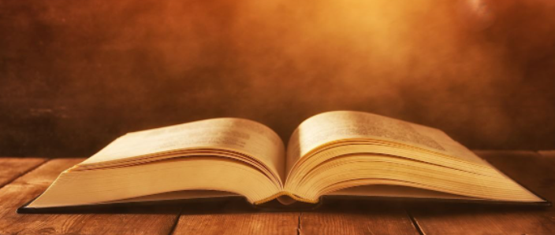
Scripture Reading
The Beatitudes
Matthew 5:10-12

Slide 3
Beatitudes
VISIBLE/EXTERNAL
Persecuted for Good
Peace-makers
Merciful
Meek
Pure in
Heart
H&T for
Righteousness
Mourn
Poor in Spirit
INVISIBLE/INTERNAL

Slide 4
Blessed are the persecuted…
Why must there be persecution & suffering?
For followers of Christ, persecution is inevitable
Overcoming persecution
Ultimate Goal → Sanctification

Slide 6
To God be the glory!

