Slide 1
Matt 5:1-12 Overview of the Beatitudes Pastor Sam May 29, 2022

Slide 2
Scripture Reading
The Beatitudes
Matthew 5:10-12

Slide 3
The Ridiculous: Man’s struggle to find meaning in life….

Slide 4
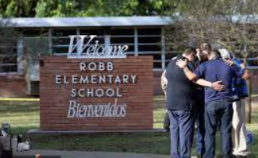
To the tragic….

Slide 5
Beatitudes
VISIBLE/EXTERNAL
Persecuted for Good
Peace-makers
Merciful
Meek
Pure in
Heart
H&T for
Righteousness
Mourn
Poor in Spirit
INVISIBLE/INTERNAL

Slide 6
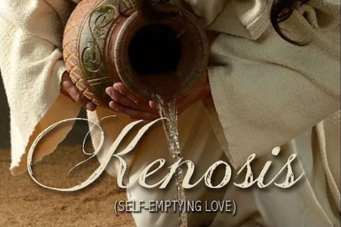
“Blessed are the Poor in Spirit…” Phil. 2:5-11

Slide 7
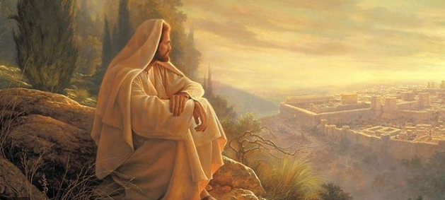
“Blessed are those who mourn…”

Slide 8
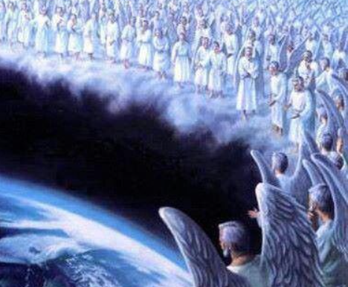
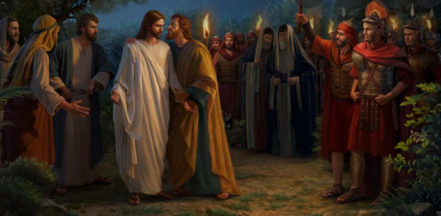
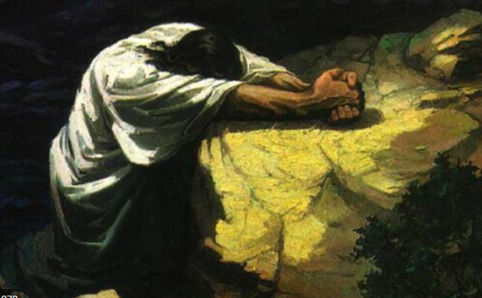
“Blessed are the meek…”

Slide 9
What Jesus hungered & thirsted for!

Slide 10
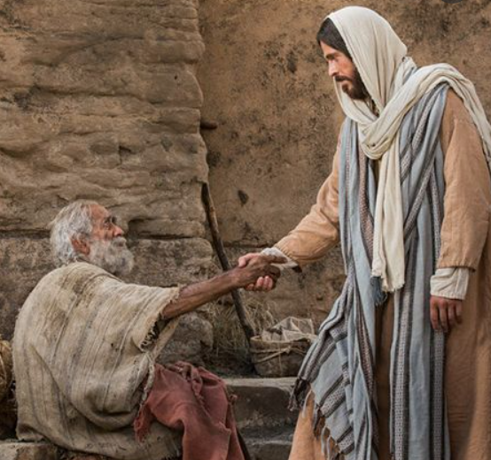
“Blessed are the merciful…”

Slide 11
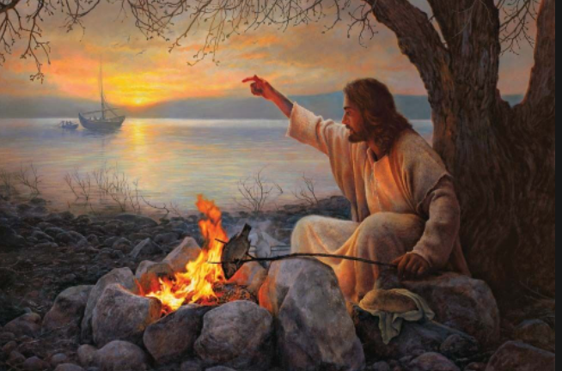
Jesus the merciful

Slide 12
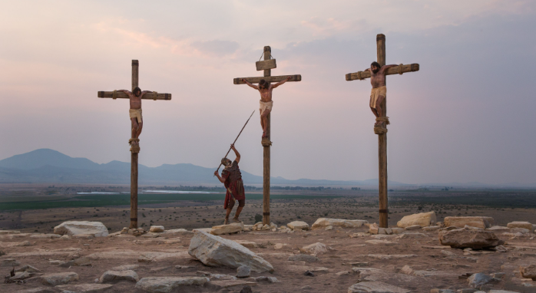
Peacemaker The Prince of Peace paid the price for our peace
Jesus the pure of heart, the perfect sacrifice
Christ persecuted for righteousness

Slide 13
Blessed are… | Blessings… | Things God hates… (Prov. 6: 16-19)
Poor in Spirit | Kingdom of Heaven | Haughty Eyes (arrogance)
Mourn | Comfort | Lying tongue
Meek | Inherit the earth | Hands that shed innocent blood
Hunger & Thirst for righteousness | Satisfaction | Heart that devises wicked plans
Merciful | Receive mercy | Those who rush to evil
Pure in Heart | See God | False witness/habitual liars
Peacemakers | Sons of God | Sows discord among brothers
Persecuted for righteousness | Kingdom of Heaven | Lake of Fire

Slide 14
To God be the glory!

