Slide 1
Matt 5:13-16 The impact of kingdom people in the world Pastor Sam June 5, 2022

Slide 2
Scripture Reading
The Beatitudes
Matthew 5:13-14

Slide 3
New short cut study method?

Slide 4
Beatitudes
VISIBLE/EXTERNAL
Persecuted for Good
Peace-makers
Merciful
Meek
Pure in
Heart
H&T for
Righteousness
Mourn
Poor in Spirit
INVISIBLE/INTERNAL

Slide 5
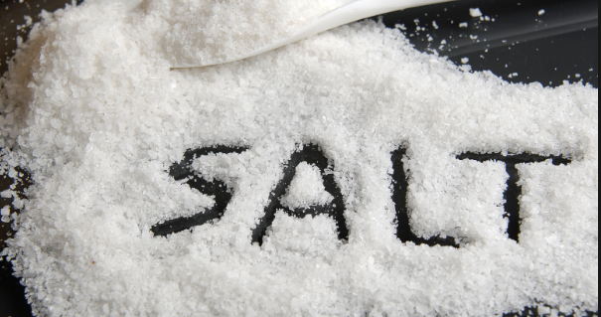
Matthew 5:13-16 (Mark 9:50ff, Luke 14:34ff)
The Impact/Influence of Jesus’s kingdom people in the world
2.

Slide 6
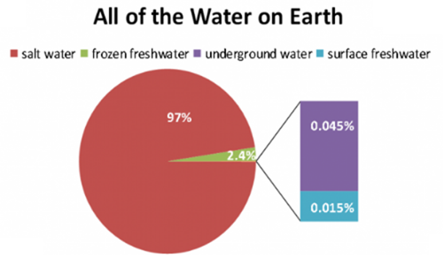
Importance of Salt & Water to Life

Slide 7
Matthew 5:13-16 (Mark 9:50ff, Luke 14:34ff)
The Impact/Influence of Jesus’s kingdom people in the world
2.

Slide 8
Contrasting Salt vs. Light Qualities of Jesus disciples
 | Salt | Light
Appearance | White/Pure | White/Bright
Visible | Invisible | Visible
Main effect | Preservation: Retards decay | Transformation: Dark → Light
Concerns | Lose saltiness Good for nothing | Cover/Hide Lose effect

Slide 9
To God be the glory!

