Slide 1
True Kingdom Righteousness: The meaning of “You shall not kill…” Matt. 5:21-26 Pastor Sam June 26, 2022

Slide 2
Scripture Reading
Preeminence of the Bible
Matthew 5:17-26

Slide 3
Jesus fulfilling the Word of God and leading his people to righteousness
The Temple (type) | Jesus (anti-type)
Had a door (gateway to God) | Jesus is the door
There was a laver for cleansing | Jesus’s work cleanses from sin
Lamps that needed refilling | Jesus is the light of the world
Show bread | Jesus is the bread of life
There was mercy seat | Jesus is the mercy seat

Slide 4
Contrasting hypocrisy with True Biblical Righteousness
Ref. Matt. 5 | Hypocritical righteousness Scribes/Pharisees You have heard….. (Distortions of the Word) | True Christ-like righteousness Jesus – Perfect & Holy But I say to you….. (True Interpretations of the Word)
V21-26 | Do not murder | Be careful when you are angry…
V27-30 | Do not commit adultery | Do not even lust
V31-32 | Give certificate of divorce | Do not divorce w/o cause
V33-37 | Do not swear falsely | Do not use oaths to cover lies
V38-42 | An eye/tooth for eye/tooth | Do not take personal vengeance
V43-47 | Love neighbor/hate enemies | Love enemies/pray for persecutors

Slide 5
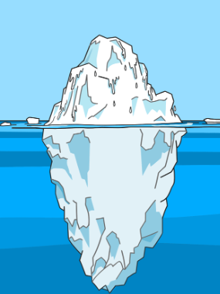
God’s righteousness
Do not kill/murder
3. Do not curse
2. Do not insult
1. Do not be angry

Slide 6
Roots of Anger….
Righteous indignation
- God’s honor
- Injustice
Personal matters
Fear
Anxiety
Sadness
Guilt (false)
Hurt
Shame
Embarrassment
Insecurity
Stress
Pain
Hunger
Fatigue
Medications
Sin
Impatience
Lack of Self-Control
Guilt (justified)
Envy
Jealousy
Coveteous
Contempt
Hatred

Slide 7
God’s righteousness
Do not kill/murder
3. Do not curse
2. Do not insult
1. Do not be angry

Slide 8
To God be the glory!

