Slide 1
True Kingdom Righteousness: Perfection Matt. 5:48 Pastor Sam August 14, 2022

Slide 2
Scripture Reading
True righteousness
Matthew 5:17-20 & 48

Slide 3
Overview of Matthew 5
“Blessed” are those who are citizens of God’s kingdom (Matt. 5:1-12)
Those in God’s kingdom will influence the world: Salt & Light (Matt. 5:13-16)
Those in God’s kingdom will manifest true righteousness (Matt. 5:17-48)

Slide 4
1. Beatitudes (Matt. 5:1-12)
VISIBLE/EXTERNAL
Persecuted for Good
Peace-makers
Merciful
Meek
Pure in
Heart
H&T for
Righteousness
Mourn
Poor in Spirit
INVISIBLE/INTERNAL

Slide 5
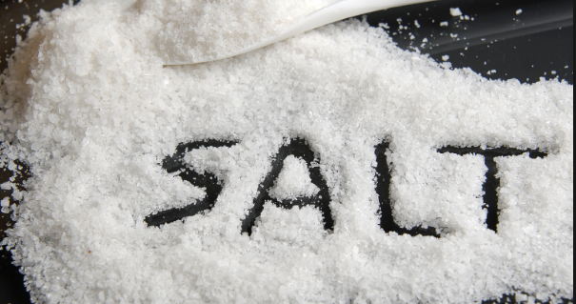
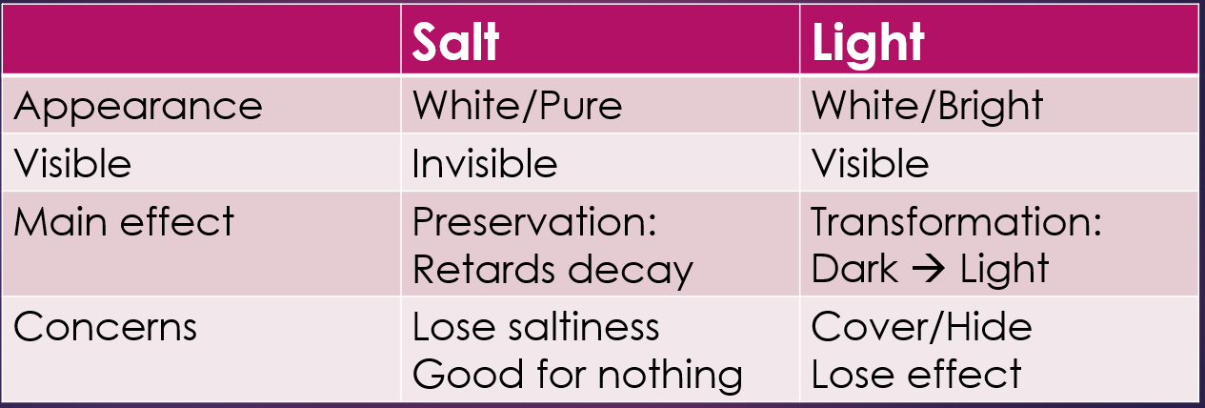
2. Matthew 5:13-16 (Mark 9:50ff, Luke 14:34ff)
The Impact/Influence of Jesus’s kingdom people in the world
2.

Slide 6
3. True Righteousness: Perfection
Ref. Matt. 5 | Hypocritical righteousness Scribes/Pharisees You have heard….. (Distortions of the Word) | True Christ-like righteousness Jesus – Perfect & Holy But I say to you….. (True Interpretations of the Word)
V21-26 | Do not murder | Be careful when you are angry…
V27-30 | Do not commit adultery | Do not even lust…
V31-32 | Give certificate of divorce | Do not divorce w/o cause
V33-37 | Do not swear falsely | Speak Truth
V38-42 | An eye/tooth for eye/tooth | Do not take personal vengeance
V43-47 | Love neighbor/hate enemies | Love enemies/pray for persecutors

Slide 7
How then should we live?
1. Start by examining yourself
2. Love the Body of Christ
Spur “one another” to love and good works
Expose and admonish false believers
3. Love unbelievers
Share the gospel (“good news”)
Share love, including enemies

Slide 8
To God be the glory!

