Slide 1
True Religion: Praying The Disciples Prayer: Heaven Matt. 6:9-13 Pastor Sam October 2, 2022

Slide 2
Scripture Reading
True Religion: Praying
Matthew 6:9-13

Slide 3
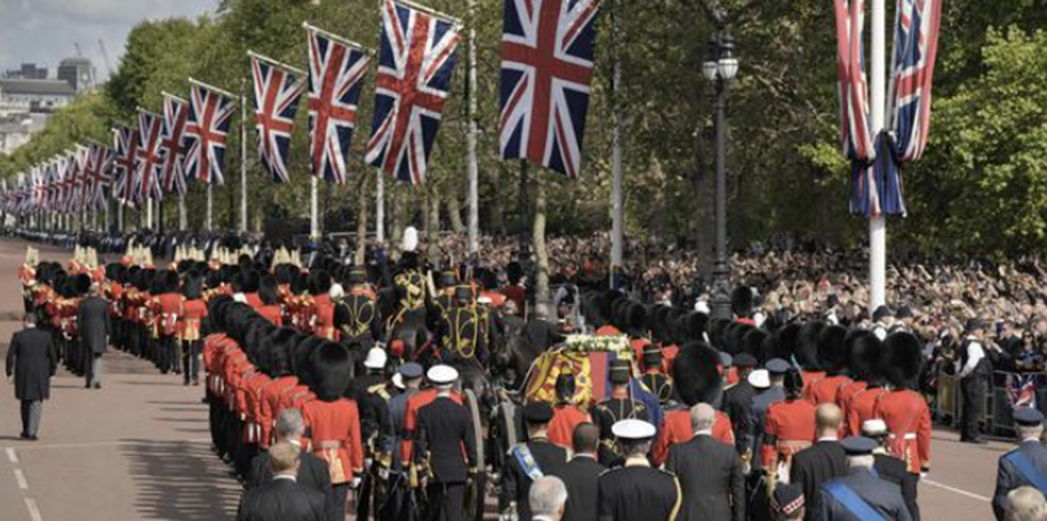
Queen Elizabeth Funeral Procession 9/19/22

Slide 4
The Lord’s model prayer Our Abba Father Hallowed be your name
Heaven
Home
LOVE
HOLY

Slide 5
Heaven
Home
Our Abba Father
LOVE
God’s
name is
HOLY
God’s Rule Kingdom
God’s will done
God’s Kingdom come
God’s will be done
More intimacy & children
More Righteousness

Slide 6
Your Kingdom come….
Recognition that we are in a war
There are only 2 kingdoms
Examine your life? Is God your King?

Slide 7
How then should we pray?
Your kingdom come.....
Thank our loving Abba Father
Worship Holy God
Make His Kingdom our priority in life and in prayer

Slide 8
To God be the glory!

