Slide 1
True Relationships with Brothers & others Matt. 7:1-6 Pastor Sam December 4, 2022

Slide 2
Scripture Reading
True Relationships with
Brothers & others
Matthew 7:1-6

Slide 3
True relationship with brothers & others
Matt. 7:1 Judge not…
Matt 7:2-5 Dealing with Brothers
Matt. 7:6 Dealing with others

Slide 4
So what should we do?
Be diligent in identifying & dealing with “logs”
Once we see clearly, help our brothers with their “specks”
Avoid “dogs” and “pigs”
Others: share the gospel!
James 1:19

Slide 5
To God be the glory!

Slide 6
Announcements

Slide 7
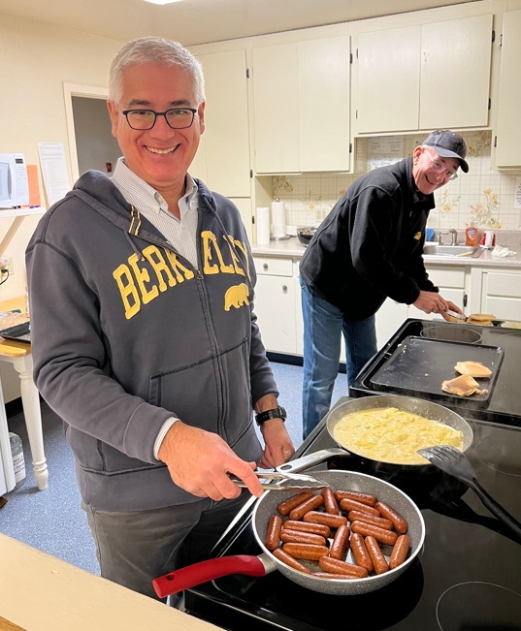
Men’s breakfast prep…

