Slide 1
God is in control Romans 8:28-30 Pastor Sam January 1, 2023

Slide 2
Scripture Reading
God is in control
Romans 8:28-30

Slide 3
Romans 8:28 Conditional Promise
Only applies to true followers of Christ
There are only 2 types of people

Slide 4
Reflections on Romans 8:28
God is the source/power
God’s Providence
Biblical examples
Importance of faith
Danger of the “temporal & the seen”

Slide 5
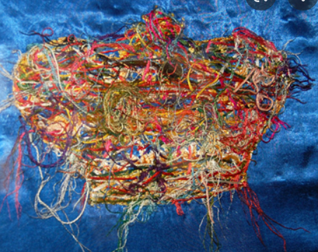
Underside of the tapestry

Slide 6
Front side of the tapestry

Slide 7
To God be the glory!

