Slide 1
Warning #1: True vs. False Prophets (Part 2) Matt. 7:13-20 Pastor Sam January 22, 2023

Slide 2
Scripture Reading
Warning #1: True vs. False Prophets
Matthew 7:13-20

Slide 3
Important truths in dealing with false prophets
We must know the Word of God
John 1:1 Jesus is the Word
2 Tim 3:16 – All scriptures is God breathed…
Luke 24:13-35 – The Bible is about Jesus
Acts 17 – Bereans: diligence in testing any teaching against the Word of God

Slide 4
2. We must be diligent to know correct doctrine: A1)Sufficiency of Scripture
1644 London Confession:
The Holy Scripture is the only sufficient, certain, and infallible rule of all saving knowledge, faith, and obedience
1846 Liverpool Conference of Evangelicals:
We believe the Bible to be inspired, infallible, authoritative Word of God.

Slide 5
2. We must be diligent to know correct doctrine: A2)Sufficiency of Scripture
1644 London Confession:
The Holy Scripture is the only sufficient, certain, and infallible rule of all saving knowledge, faith, and obedience
Local Large Evangelical Church:
The Bible includes both Old & New Testaments, is divine revelation, the original autographs of which were verbally inspired by the Holy Spirit

Slide 6
2. We must be diligent to know correct doctrine: B) Gospel/Justification
Gospel (+) is not a Gospel
Gospel (-) is not a Gospel
Stern warning from the Apostle Paul (Gal. 1:6-9)

Slide 7
Important truths in dealing with false prophets
We must know the Word of God
We must be diligent to know correct doctrine
We must be part of a Church
We must be under the teaching/authority of godly Elders
We must be vigilant about false teachers
Consider why God allowed for false teachers

Slide 8
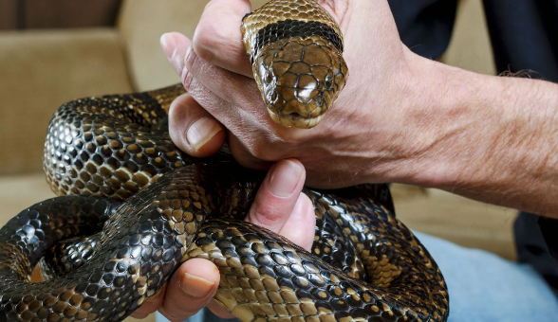
False Pastors Teachers

Slide 9
To God be the glory!

Slide 10
So what then should we do?
Be diligent to study the Bible
Be diligent to know correct doctrine
Be connected to the Body of Christ
Get to know & pray for your Elders (mutual)
Be vigilant regarding false Pastors/teachers
Remember: ultimately God’s purpose will prevail

