Slide 1
Warnings: #3 Life built on the rock vs. sand Matt. 7:24-27 Pastor Sam February 12, 2023

Slide 2
Scripture Reading
Warning #3: Life built on the rock vs. sand
Matthew 7:24-27

Slide 3
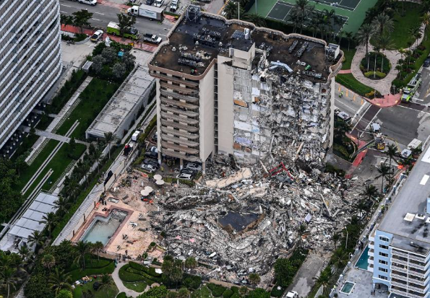
Surfside FL 12 Story Condo

Slide 4
Review
“Enter through the narrow gate.”
Warnings:
Beware of false teachers
Beware of a false confession
Beware of building your life on a false foundation

Slide 5
2 Men & 2 Houses
Comparing similarities
Comparing differences
Variations on hearing
“Hearing Jesus”… → Obeying Jesus!
James 1:22-26

Slide 6
Characteristics of the Wise vs. Foolish builder
Wise (Do God’s Word) | Foolish (only hear God’s Word)
Patient | Impatient
Detailed | Careless
Considers the long term (eternity) | Focus on the near term (this life)

Slide 7
Testing the foundation of your life
Days of testing – this life
The Day of testing – final judgment
Call to examine yourself
Direction: Godliness or wickedness?

Slide 8
To God be the glory!

