Slide 1
Matt 5 – 7 Sermon on the Mount Overview Pastor Sam February 19, 2023

Slide 2
Overview of the Sermon on the Mt. Matthew 5-7
5:3-12 True character (Beatitudes)
5:13-16 True manifestation (salt & light)
5:17-48 True Righteousness → Perfection (spirit of the law)
6:1-18 True Religion: Giving, Praying, Fasting
6:19-34 True Life priorities: Seek 1st Kingdom of God
7:1-12 True Relationships: 1) Love God; 2) Love others
7:13-14 Call to Action – “Enter through narrow gate”

Slide 3
I. True Character – Matt. 5:3-12 Beatitudes
VISIBLE/EXTERNAL
Persecuted for Good
Peace-makers
Merciful
Meek
Pure in
Heart
H&T for
Righteousness
Mourn
Poor in Spirit
INVISIBLE/INTERNAL

Slide 4
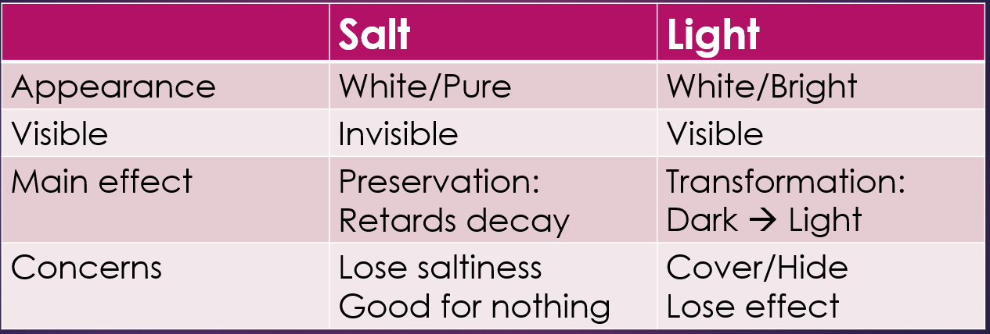
II. True manifestation of Kingdom people Matthew 5:13-16 (Mark 9:50ff, Luke 14:34ff)
The Impact/Influence of Jesus’s kingdom people in the world
2.

Slide 5
III. True Righteousness: Perfection
Ref. Matt. 5 | Hypocritical righteousness Scribes/Pharisees You have heard….. (Distortions of the Word) | True Christ-like righteousness Jesus – Perfect & Holy But I say to you….. (True Interpretations of the Word)
V21-26 | Do not murder | Be careful when you are angry…
V27-30 | Do not commit adultery | Do not even lust…
V31-32 | Give certificate of divorce | Do not divorce w/o cause
V33-37 | Do not swear falsely | Speak Truth
V38-42 | An eye/tooth for eye/tooth | Do not take personal vengeance
V43-47 | Love neighbor/hate enemies | Love enemies/pray for persecutors

Slide 6
IV. True Relgion: 1) Giving; 2) Praying; 3) Fasting
Heaven
Home
Our Abba Father
LOVE
God’s name
HOLY
Matt. 6:1-18
God’s Kingdom come
God’s will be done
Today: Give us our Daily Bread
Looking back
Forgive us…
as we forgive
Looking forward
Protect us &
Deliver us

Slide 7
V. True Priorities of life Matt. 6:19-34
Seek first the kingdom of God and His righteousness
Lay up treasures in Heaven
Stop being anxious about the things of this life
Keep your focus on today

Slide 8
VI. True Relationships Matt. 7:1-12
First judge self, then others to help
Personal “logs” → other’s “specks”
Avoid “dogs” & “pigs”
Consider God’s gracious love
Love others (Golden Rule)

Slide 9
VII. Call to Action
“Enter through the narrow gate”
Warnings:
False Teachers
False Confession (saying only)
False Foundation (hearing only)

Slide 10
REACTIONS?

Slide 11
To God be the glory!

