Slide 1
Matthew 9:27-34 Jesus’s authority over blindness & demonic muteness Pastor Sam May 7, 2023

Slide 2
Scripture Reading
Jesus’s authority over blindness & demonic muteness
Matthew 9:27-34

Slide 3
Jesus’s Power | Miracles Proving Jesus is God | Matthew 8-9
Physical Healing | Healing Leper w/ touch | 8:1-4
 | Healing w/ word/distance (Centurion) | 8:5-13
 | Healing sickness w/ touch | 8:14-17
Post healing reactions | Rejection of half-hearted disciples | 8:18-22
The Natural & supernatural: demonic powers & forgiving of sins | Calming a fierce storm | 8:23-27
 | Exorcism of demons | 8:28-34
 | Forgiveness of sins/healing of paralytic | 9:1-8
Post Miracles reactions | Sinners - Yes! Religionist – No! | 9:9-17
Dying & Death | Healing of the Woman bleeding for 12 years & healing of 12 yr. old girl who died | 9:18-26
Blindness | Healing of two blind men | 9:27-31
Mute/Deaf - Demonic | Casting out of an oppressive demon | 9:31-34

Slide 4
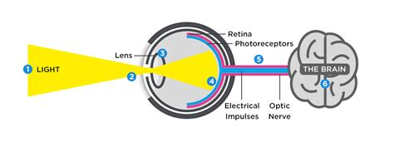
The Vision chain..…

Slide 5
Jesus’s Power | Miracles Proving Jesus is God | Matthew 8-9
Physical Healing | Healing Leper w/ touch | 8:1-4
 | Healing w/ word/distance (Centurion) | 8:5-13
 | Healing sickness w/ touch | 8:14-17
Post healing reactions | Rejection of half-hearted disciples | 8:18-22
The Natural & supernatural: demonic powers & forgiving of sins | Calming a fierce storm | 8:23-27
 | Exorcism of demons | 8:28-34
 | Forgiveness of sins/healing of paralytic | 9:1-8
Post Miracles reactions | Sinners - Yes! Religionist – No! | 9:9-17
Dying & Death | Healing of the Woman bleeding for 12 years & healing of 12 yr. old girl who died | 9:18-26
Blindness | Healing of two blind men | 9:27-31
Mute/Deaf - Demonic | Casting out of an oppressive demon | 9:31-34

Slide 6
Responses to Jesus…..
Genuine Faith
Detached amazement
Rejection/Mocking
Growing religious opposition

Slide 7
The rest of the story…
Vision and hearing are the most sensitive of the senses.
Jesus’s focus is on the spiritual, not the physical.

Slide 8
To God be the glory!

