Slide 1
Matthew 10:16-25 The cost of being a disciple of Christ Pastor Sam June 11, 2023

Slide 2
Scripture Reading
The cost of being a disciple of Christ
Matthew 10:16-25

Slide 3
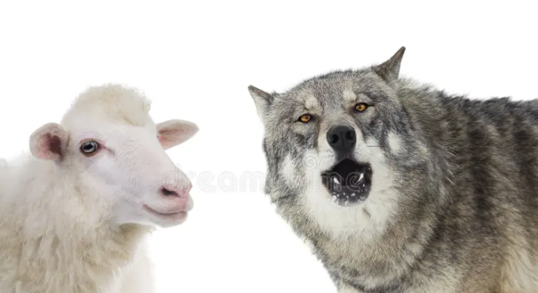
Matthew 10:16-25 The cost of being a disciple of Christ…
Hostile environment
Persecution: Secular & Sacred
Enmity/Betray by family
Hated by all

Slide 4
Strategies for the true disciples…
Category | Strategy
Hostile Environment | John 10 – listen to Shepherd Matt.10:16b Shrewd as serpents & innocent as doves
Persecution: Sacred & Secular | Matt. 10:19-20 Fear not. Holy Spirit will give the words.
Enmity/Betrayal by family | Endure to the end → Salvation Keep moving, flee persecution Remember the example of Jesus
Hated by all

Slide 5
To God be the glory!

Slide 6
Proposed new logos for LHC

