Slide 1
The Secrets of the Kingdom: Parable of the Wheat & Tares (Darnel Wheat) Pastor Sam December 3, 2023

Slide 2
Scripture Reading
Title of Sermon
Bible Reference

Slide 3
Parable of the Good Seed (Wheat) & the Tares (Darnels)
Sower = Son of Man, King Jesus, the Christ/Messiah | Enemy – the Devil, Satan, the Evil One, Accuser, Slanderer
Good Seed = sons of God | Weeds = sons of the Evil One
Harvest = the End of the Age | Field = the World
Reapers = Angels (not people)
Good Seed (Wheat) to be gathered and put into God’s Kingdom | Weeds/Tares/Darnels to be gathered up and burned in Hell/Lake of Fire

Slide 4
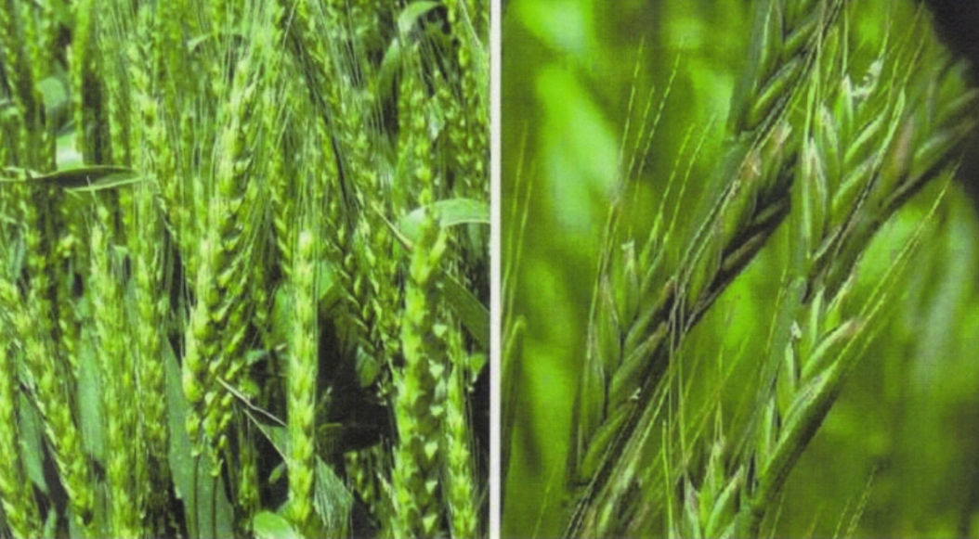
Wheat Tares/Darnels

Slide 5
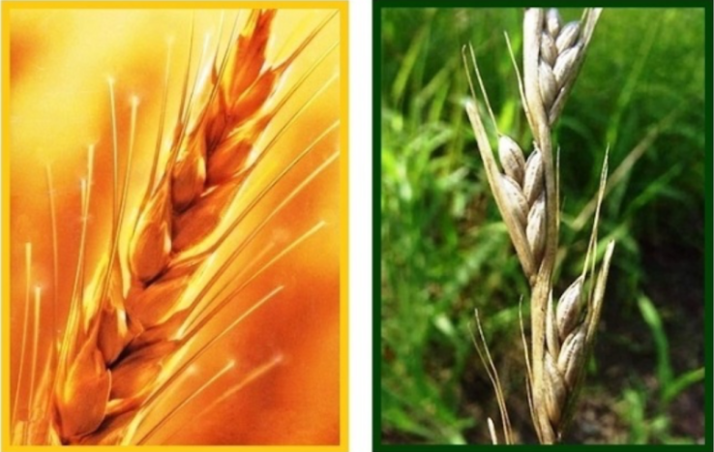
AT Harvest…..
Wheat Tares/Darnels

Slide 6
Parable of the Good Seed (Wheat) & the Tares (Darnels)
Sower = Son of Man, King Jesus, the Christ/Messiah | Enemy – the Devil, Satan, the Evil One, Accuser, Slanderer
Good Seed = sons of God | Weeds = sons of the Evil One
Harvest = the End of the Age | Field = the World
Reapers = Angels (not people)
Good Seed (Wheat) to be gathered and put into God’s Kingdom | Weeds/Tares/Darnels to be gathered up and burned in Hell/Lake of Fire

Slide 7
Implications for us today…
Jesus is the one who plants his children as he pleases.
Satan is planting his children right along side wherever Jesus is planting.
The sons of God and the devil will grow up together until the End of the Age.

Slide 8
To God be the glory!

