Slide 1
The Secrets of the Kingdom: Parable of the Mustard Seed & the Leaven Pastor Sam December 10, 2023

Slide 2
Scripture Reading
The Parable of the Mustard Seed & Leaven
Matthew 13:31-33

Slide 3
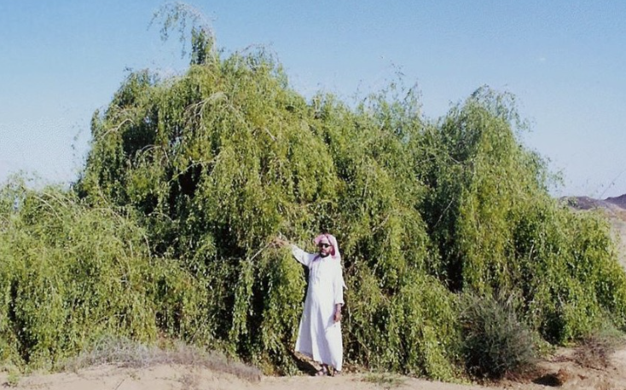
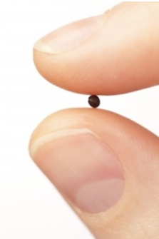
Mustard Seed/Herb Bush (Tree)
Mustard Seed
(1-2mm)
➔ Mustard Bush

Slide 4
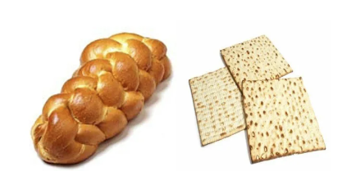
With Leaven vs. without Leaven
Bread

Slide 5
To God be the glory!

