Slide 1
The Secrets of the Kingdom: Why Jesus came into the World? Pastor Sam December 24, 2023

Slide 2
Scripture Reading
Why Jesus came into the World?
Matthew 13:47-50

Slide 3
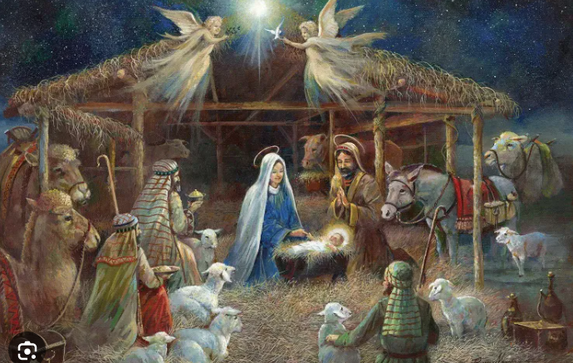
Merry Christmas
But Why?

Slide 4
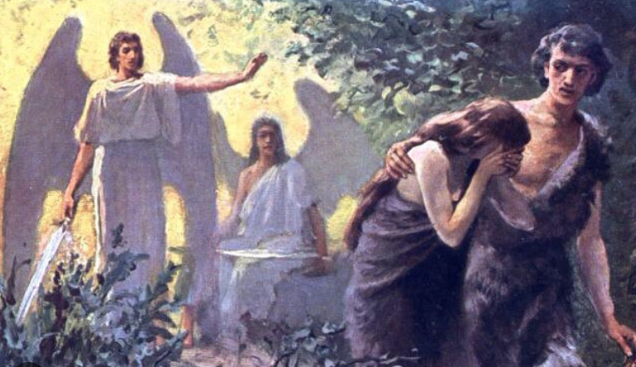
The Fall of Man

Slide 5
Matthew 13:47-50
⁴⁷ “Again, the kingdom of heaven is like a net that was thrown into the sea and gathered fish of every kind. ⁴⁸ When it was full, men drew it ashore and sat down and sorted the good into containers but threw away the bad. ⁴⁹ So it will be at the end of the age. The angels will come out and separate the evil from the righteous
⁵⁰ and throw them into the fiery furnace. In that place there will be weeping and gnashing of teeth.

Slide 6
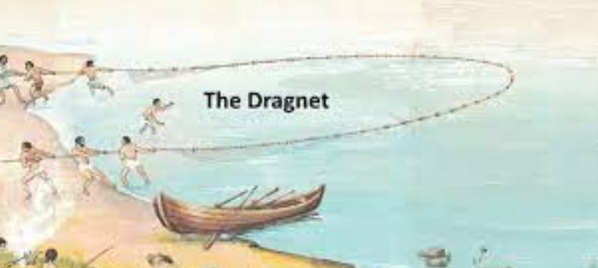
Secrets of the Kingdom: Parable of the Dragnet – the end of the age

Slide 7
Luke 16:19-31
“There was a rich man who was clothed in purple and fine linen and who feasted sumptuously every day. ²⁰ And at his gate was laid a poor man named Lazarus, covered with sores, ²¹ who desired to be fed with what fell from the rich man's table. Moreover, even the dogs came and licked his sores. ²² The poor man died and was carried by the angels to Abraham's side.^{[f]} The rich man also died and was buried, ²³ and in Hades, being in torment, he lifted up his eyes and saw Abraham far off and Lazarus at his side. ²⁴ And he called out, ‘Father Abraham, have mercy on me, and send Lazarus to dip the end of his finger in water and cool my tongue, for I am in anguish in this flame.’ ²⁵ But Abraham said, ‘Child, remember that you in your lifetime received your good things, and Lazarus in like manner bad things; but now he is comforted here, and you are in anguish. ²⁶ And besides all this, between us and you a great chasm has been fixed, in order that those who would pass from here to you may not be able, and none may cross from there to us.’ ²⁷ And he said, ‘Then I beg you, father, to send him to my father's house— ²⁸ for I have five brothers—so that he may warn them, lest they also come into this place of torment.’ ²⁹ But Abraham said, ‘They have Moses and the Prophets; let them hear them.’ ³⁰ And he said, ‘No, father Abraham, but if someone goes to them from the dead, they will repent.’ ³¹ He said to him, ‘If they do not hear Moses and the Prophets, neither will they be convinced if someone should rise from the dead.’”

Slide 8
Jesus’s teaching about Hell in Matthew
5:21-22 Hell fire for haters of people
8:5-13 a place of weeping & gnashing of teeth
11:20-24 – worse in hell for cities of Israel who rejected Jesus than evil gentile cities.
12:36 – every careless word subject to judgment
18:5-6 – for those who would lead a little one astray, better to have a large milestone tied to their neck and drowned in the depth of the sea (hell)
18:7-9 Better to be in heaven with feet/hand/eye missing, than to be in hell.
23:13-15 Certain hell/woe to Scribes/Pharisees

Slide 9
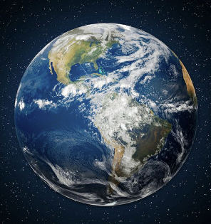
Range of experience: “Floors” & “Ceilings”
Best
Heaven
Believers
Un-Believers
Best
Worst
Hell
Worst

Slide 10
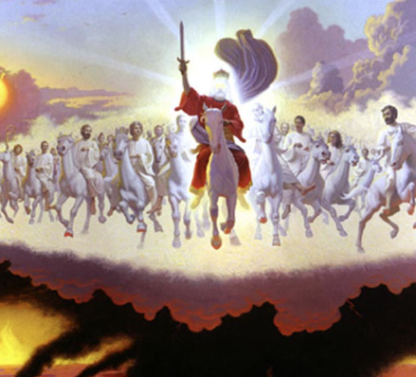
The Second Coming will not be like the first…

Slide 11
To God be the glory!

