Slide 1
Jesus, Truly the Son of God Matthew 14:22-33 Pastor Sam January 28, 2023

Slide 2
Scripture Reading
Jesus, Truly the Son of God
Matthew 14:22-32

Slide 3
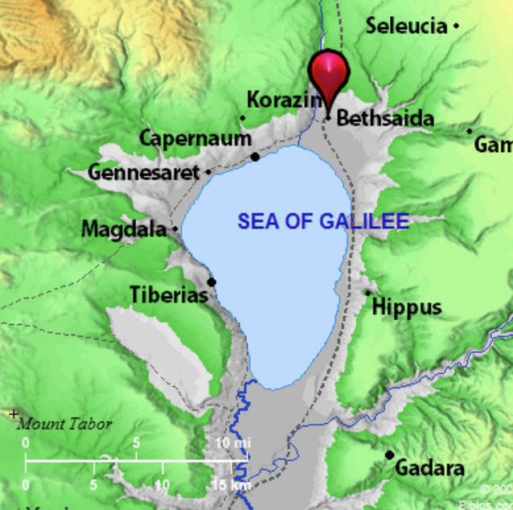
Jesus commands his disciples to go back to the other side…

Slide 4
<
Moses (Deut.18:14-19) | JESUS (Heb. 3:3-4)
Israel in the desert | Jews in the desert
Organized by Tribe | Organized by 50s & 100s
Messenger that God would provide Manna | Personally multiplied food to feed the people
Led Israel through the Red Sea | Walked on top of the Sea of Galilee
Fierce wind parted the Red Sea | Fierce wind threatened disciples
After crossing the Red Sea → Peace | After Jesus got in the boat → Peace

Slide 5
Fulfillment of Psalm 107:25-30
For he commanded and raised the stormy wind, which lifted up the waves of the sea. ²⁶ They mounted up to heaven; they went down to the depths; their courage melted away in their evil plight; ²⁷ they reeled and staggered like drunken men and were at their wits' end.²⁸ Then they cried to the Lord in their trouble, and he delivered them from their distress. ²⁹ He made the storm be still, and the waves of the sea were hushed. ³⁰ Then they were glad that the waters were quiet, and he brought them to their desired haven. ³¹ Let them thank the Lord for his steadfast love, for his wondrous works to the children of man!

Slide 6
Application
The Lord knows what is best for us.
He will send trials to: a) test our faith; b) stretch us so that we might grow
In times of trial, we need to PRAY!
Over time, we must grow in our worship of King Jesus

Slide 7
To God be the glory!

