Slide 1
A Surprising Example of Great Faith Matthew 15:21-28 Pastor Sam February 18, 2023

Slide 2
Scripture Reading
A Surprising Example of Great Faith
Matthew 15:21-28

Slide 3
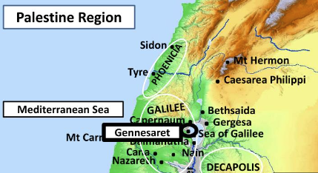

Slide 4
The right way to approach Jesus
“Have mercy on me”
“O Lord”
“Son of David”

Slide 5
Two Key lessons
The great “mega” faith of this Canaanite woman
Taking the disciples to school….Spiritual lessons

Slide 6
The great “mega” persistent faith of the Canaanite woman revealed by the testing of her faith.
Silent treatment by Jesus
Rejection by the disciples
“I was sent only to the lost sheep of the house of Israel”
“It is not right to take the children’s bread and throw it to the dogs.”

Slide 7
Taking the disciples to school…..
Progression | The 5000 men | Scribes & Pharisees | Canaanite Woman
Perceived Need | Hunger | “None” – self righteous | To get to Jesus
Request | “Be our King” | Obey the tradition of the Elders | Heal my daughter
Jesus Push Back | Obey me: eat my flesh & drink my blood | Obey God’s commandments | Focus on Israel
Response to Jesus | Rejection | Anger - Left Jesus | Begged for crumbs
Aftermath | Stopped following Jesus | Plotted revenge | Daughter healed + Salvation

Slide 8
Key take-aways on True Faith…
True faith approaches Jesus in reverence and humility (Matt. 15:21-28)
True faith seeks Jesus with diligence (Mark 12:30)
True faith comes from hearing Jesus (Rom. 10:17)
True faith is persistent (Gal. 6:9)
True faith puts its entire trust in God (Rom. 8:28)
Truth faith knows that God is generous (Heb. 11:6)
True faith is a matter of the heart (1 Sam 16:7)

Slide 9
To God be the glory!

