Slide 1
Compassion on the Gentiles Too Matthew 15:29-39 Pastor Sam February 25, 2023

Slide 2
Scripture Reading
Compassion on the Gentiles too!
Matthew 15:29-39

Slide 3
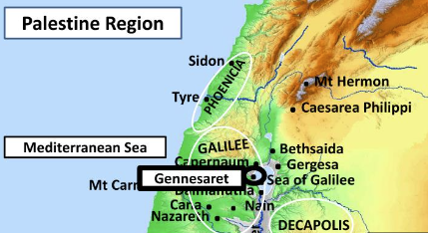

Slide 4
Comparing feeding of 5000 vs. 4000
 | Feeding of 5000 | Feeding of 4000
 | Similarities
 | Jesus moved by compassion
 | Asked disciples about provisions
 | Few fish & loaves
 | All people ate until satisfied
Differences | Left by boat, then conflict with Scribes/Pharisees
Vast multitude | 5000 men | 4000 men
Location: In the wilderness | Near Bethsaida (Israel) | Decapolis (Syria)
Duration | 1 Day | 3 Days
Asks disciples about provisions | Little boy: 5 loaves/2 fish | Disciples: 7 loaves/few fish
Abundance of leftovers | 12 Jewish baskets | 7 Gentile baskets (cf Acts9)

Slide 5
The right way to approach Jesus
“Have mercy on me”
“O Lord”
“Son of David”

Slide 6
Two Key lessons
The great “mega” faith of this Canaanite woman revealed by the testing of her faith.
Taking the disciples to school….Spiritual lessons

Slide 7
The great “mega” persistent faith of the Canaanite woman revealed by the testing of her faith.
Silent treatment by Jesus
Rejection by the disciples
“I was sent only to the lost sheep of the house of Israel”
“It is not right to take the children’s bread and throw it to the dogs.”

Slide 8
Taking the disciples to school…..
Progression | The 5000 men | Scribes & Pharisees | Canaanite Woman
Perceived Need | Hunger | “None” – self righteous | To get to Jesus
Request | “Be our King” | Obey the tradition of the Elders | Heal my daughter
Jesus Push Back | Obey me: eat my flesh & drink my blood | Obey God’s commandments | Focus on Israel
Response to Jesus | Rejection | Anger - Left Jesus | Begged for crumbs
Aftermath | Stopped following Jesus | Plotted revenge | Daughter healed + Salvation

Slide 9
Key take-aways….
Only God could have performed such healings as Jesus did (Matt. 15:29-31)
Believers will glorify God and give thanks to him in every circumstance (1 Thes. 5:16-18)
We need to follow Jesus’s example to love and have compassion for even people that we might deem as enemies. (Matt. 5:43-47)
Foreigners/Gentiles take heart (Matt. 11:28-30)

Slide 10
To God be the glory!

