Slide 1
Good Friday Service Genesis 15, Isaiah 53, Galatians 3 Pastor Sam March 29, 2024

Slide 2
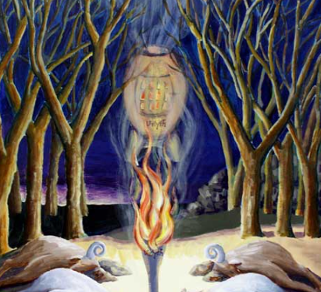
God’s Covenant With Abraham Genesis 15

Slide 3
Isaiah 53 & Galatians 3:13-14

Slide 4
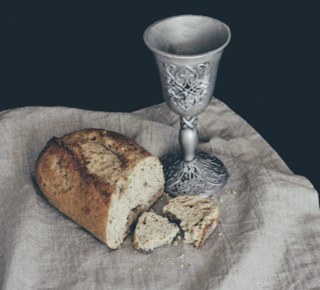
Communion 1 Corinthians 12:23-32

Slide 5
To God be the glory!

