Slide 1
Balancing Heavenly & Earthly Citizenship Matthew 17:22-27 Pastor Sam June 23, 2024

Slide 2
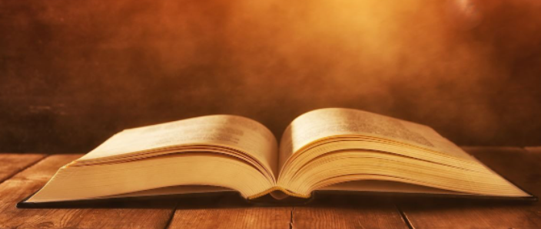
Scripture Reading
Balancing Heavenly & Earthly Citizenship
Matthew 17:22-27

Slide 3
Should Jesus, the Son of God, have to pay the temple tax for the upkeep of the Temple?

Slide 4
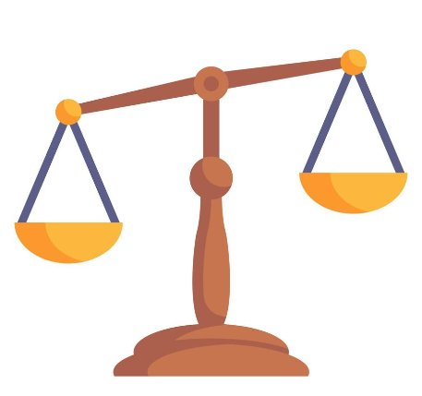
Balancing Citizenship
Earth
Heaven

Slide 5
To God be the glory!

