Slide 1
The Seeing Blind Matthew 20:29-34 Pastor Sam Kim October 27, 2024

Slide 2
Scripture Reading
The Seeing Blind
Matthew 20:29-34

Slide 3
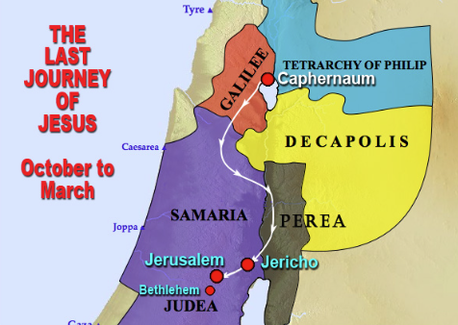
Dead Sea

Slide 4
Matthew 20:29-34
²⁹ And as they went out of Jericho, a great crowd followed him. ³⁰ And behold, there were two blind men sitting by the roadside, and when they heard that Jesus was passing by, they cried out, “Lord, have mercy on us, Son of David!” ³¹ The crowd rebuked them, telling them to be silent,
but they cried out all the more, “Lord, have mercy on us, Son of David!” ³² And stopping, Jesus called them and said, “What do you want me to do for you?”
³³ They said to him, “Lord, let our eyes be opened.”
³⁴ And Jesus in pity touched their eyes, and immediately they recovered their sight and followed him.

Slide 5
Matthew 20:29-34 Lessons from the healing of the two beggars
The Amazing compassionate heart of our Lord Jesus.
The worst affliction of humanity is spiritual blindness. (Matt. 6:22-23; 2 Cor. 4:4; Isaiah 6:9-10; John 3:19-20)
True followers of Christ will seek God with all their heart. (Jer. 29:13; Matt. 11:12; Matt. 20:29-34; Matt. 10:37-39)

Slide 6
To God be the glory!

