Slide 1
Allegiance to Caesar vs. God Matthew 22:15-22 Pastor Sam December 8, 2024

Slide 2
Scripture Reading
Allegiance to Caesar
vs. God
Matthew 22:15-22

Slide 3
In Review….
 | 3 Judgment Parables
Category | Parable #1 Matt. 21:28-32 | Parable #2 Matt. 21:33-46 | Parable #3 Matt. 22:1-14
Parable | Obedient vs. Disobedient son | Tenant Farmers | Wedding Feast
Blessings | Those who heard & repented: tax collectors & prostitutes | Faithful O.T. Prophets | Those who accept the Royal Invitation (Gentiles)
Judgment | Rejectors of Christ: Religious leaders & peoples | Disobedient Rulers of Israel | Rejecting Israel & unrighteous

Slide 4
Looking forward….
3 Questions to “test” Jesus
Test #1 Matt. 22:15-22 | Test #2 Matt. 22:23-33 | Test #3 Matt. 22:34-40
Pharisees & Herodians | Sadducees | Pharisees – Selected Expert in the Law
Paying taxes to Caesar | Resurrection | Greatest Command

Slide 5
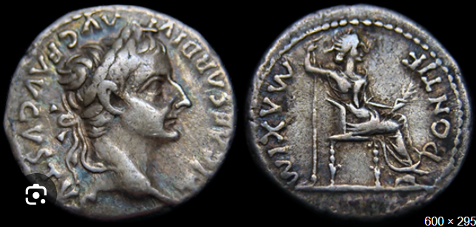
Silver Denarius at the time of Christ
Picture of Caesar Caesar as High Priestly

Slide 6
Application for us today….
Seek First the Kingdom of God. (Matthew 6:33)
Strive to be the best citizens possible. (Rom. 13:1; 1 Peter 2:13-15)
If a conflict arises, God must have the priority. (Acts 5:28-29)
Worship of God is essential
God’s creation order must not be violated

Slide 7
To God be the glory!

