Slide 1
The Importance of the Resurrection Matthew 22:23-33 Pastor Sam December 15, 2024

Slide 2
Scripture Reading
The Importance of the Resurrection
Matthew 22:23-33

Slide 3
About the Sadducees....
Focus only on the Pentateuch
Little interest in the Prophets
No interest in the Teaching of the Elders
Did not believe in an afterlife
Jesus called them hypocrites
“Levirate marriage” – Deut. 25:5-6

Slide 4
Jesus’s response….
You are wrong!
You do not understand the Bible
You do not know the power of God

Slide 5
Application
What is the condition of your soul?
Believer? (Rom. 10:9; John 1:12)
Unbeliever?

Slide 6
To God be the glory!

Slide 7
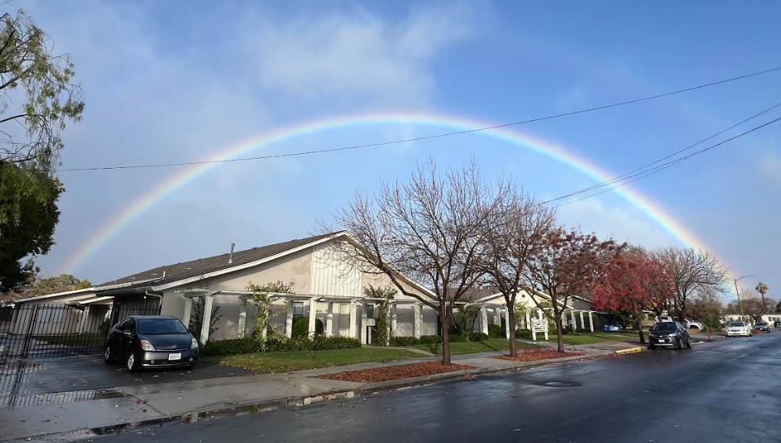
Double Rainbow over Lone Hill Church

